Slide 1
DeepFakes
Explained for Beginners
What is DeepFake?
What are it’s consequences?
How to create a DeepFake?
How to detect a DeepFake?

Slide 2
DeepFakes
wikipedia

Slide 3
Consequences
theverge.com

Slide 4
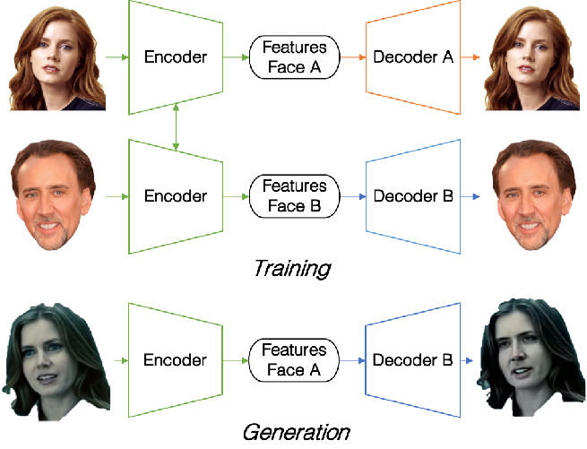
DeepFake Creation
semanticscholar.org

Slide 5
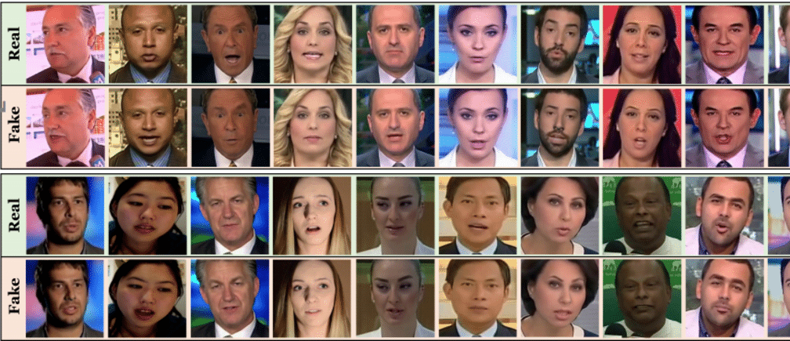
DeepFake Detection
biometricupdate.com

Slide 6
Website : www.aisciences.io

